Slide 1
Cultivating a Culture of Mindfulness in the Law Library and Beyond
Heather J.E. Simmons
Alexander Campbell King Law Library
University of Georgia School of Law

Slide 2
Notes:
When was the last time you did nothing?
TEDTalk - Ten Mindful Minutes, Andy Puddicombe, Headspace
Study: People would rather inflict pain on themselves, a mild electric shock, than do nothing

Slide 3
tl;dr
Notes:
Our lives have become so overscheduled that we are losing the ability for quiet contemplation and deep focus

Slide 4
Mindfulness what is it and how does it help?
Notes:
First, lets talk about what mindfulness is NOT. . . .

Slide 5
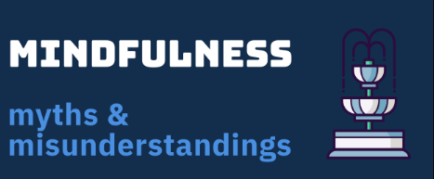
Notes:
Mindfulness strike team (header) INFOGRAPHIC – 11 items – Ann Burnett
The ability to sit still
The ability to have no thoughts

Slide 6
What Mindfulness is:
"[B]ringing our attention, with curiosity and acceptance, to bear on our present-moment experience" *
*Holly Rogers & Margaret Maytan,
Mindfulness for the Next Generation 7 (2012).
Notes:
"[B]ringing our attention, with curiosity and acceptance, to bear on our present-moment experience" *
Holly Rogers & Margaret Maytan, Mindfulness for the Next Generation 7 (2012).
The Center for Koru Mindfulness at Duke University, emerging adults
Koru a Maori word for the spiral shape of an unfurling fern frond symbolizing new life, and growth

Slide 7
It’s about the breath
Notes:
The most common focus object, it’s always there

Slide 8
The magic moment
Recognizing that your attention has strayed, and that you are no longer focusing . . .
begin again
Notes:
Sharon Salzberg
Not a vacation for your brain, but rather sending your brain to the gym to build your mindfulness muscle

Slide 9
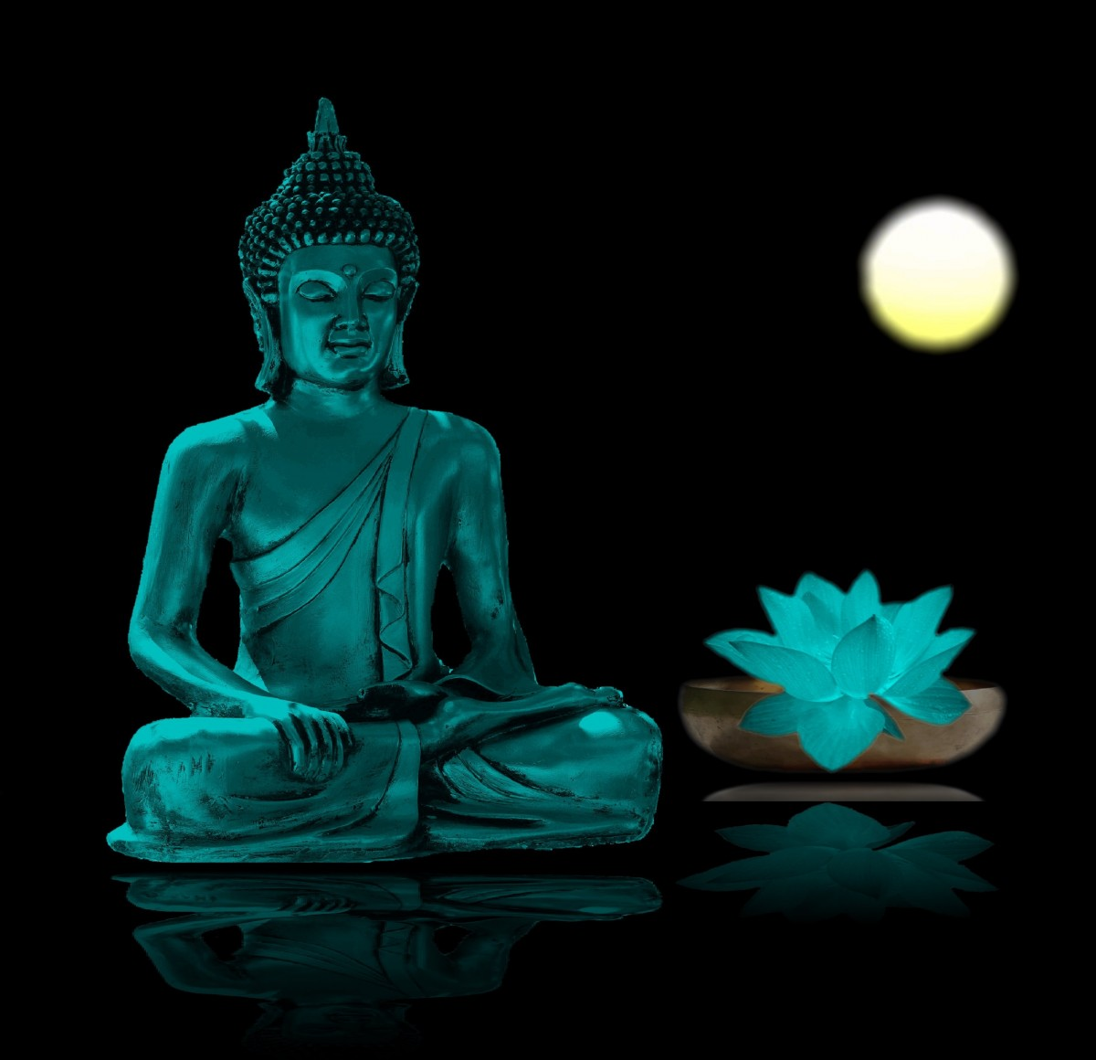
Mindfulness vs Meditation
“Meditation” carries a lot of baggage
Buddhist roots, but totally secular
https://pxhere.com/en/photo/889766
Notes:
60s and 70s “Meditation” got a bad reputation
The Beatles; Transcendental Meditation is a cult, incense, chanting, etc.
Buddhism – suffering is universal
Today, as practiced in the US it’s a totally secular activity

Slide 10
Mindfulness vs Meditation: But what is the difference?
Mindfulness is the skill
The capacity to be present
Meditation is how we cultivate the skill
“We don’t meditate to get better at meditating, we mediate to get better at life.”
Sharon Salzberg
This Photo by Unknown Author is licensed under CC BY-NC-ND

Slide 11
The Science behind Mindfulness
Evolution:
Fight or Flight
Our brains are wired for negativity
Correlation is not causation, but . . .
Notes:
As much as we might want to run screaming from the reference desk, or punch an obnoxious patron – these responses are not available to us in modern society

Slide 12
How Mindfulness helps
Stress
Anxiety
Chronic pain
Suffering and Impermanence
Notes:
Since 2016 – David Bowie died, Time travel
The antidote to the hectic-ness that is modern life

Slide 13
Types of Mindfulness Practice
Notes:
Sitting
Walking
Eating – if we had done this in person, 9 minutes to eat a raisin
Try them all to find what works for you
BUT. . . it’s not for everyone

Slide 14
Mindfulness in the Law
This Photo by Unknown Author is licensed under CC BY-NC-ND
This Photo by Unknown Author is licensed under CC BY-SA
Notes:
Mediation – emotions run high, start with a mindfulness practice to ease the tension in the room
Law firms have finally started acknowledging how stressful the practice of law is –Jeena Cho

Slide 15
For Ourselves
Self-care in a service profession
Notes:
If we don’t take car of ourselves, we can’t help other people

Slide 16
Stress & Burnout
This Photo by Unknown Author is licensed under CC BY
Notes:
We are so busy helping other people that we neglect ourselves. Mindfulness is a great way to take some time for yourself find some space to recharge.
Organizing mindfulness strike team - Not selfish at all!

Slide 17
For Our Constituents

Slide 18
How Mindfulness helps law students
Notes:
High achieving students – half will be in the bottom half of the class for the first time in their life
Complete opposite of multi-tasking
There’s no judgment
Complete opposite of law school – there is no judgment
You can’t do it wrong
Improved focus when studying
Mindfulness does not solve your problems, but it helps you to stop worrying

Slide 19
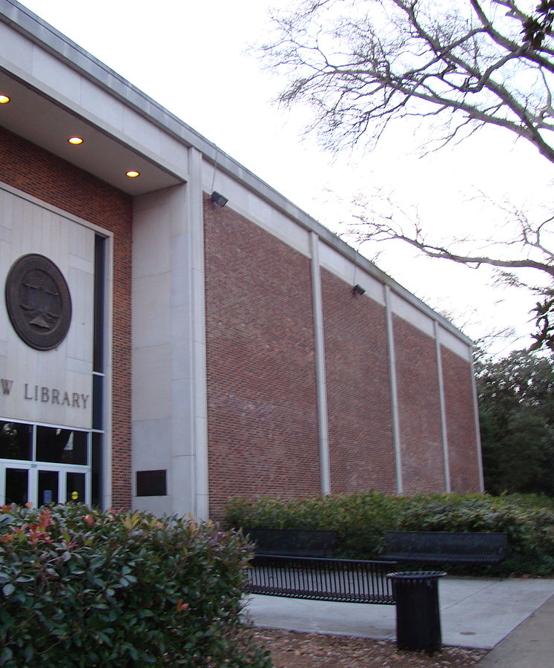
Starting a law school Mindfulness group
Biggest challenge is scheduling
Finding a time and a place to meet
If no one comes, practice by yourself
Even if you help only one person
This Photo by Unknown Author is licensed under CC BY-SA
Notes:
In conclusion – there is one thing you can do . . .

Slide 20
Go for a walk in nature
https://www.goodfreephotos.com/united-states/wisconsin/copper-falls-state-park/wisconsin-copper-falls-state-park-the-forest-path.jpg.php

Slide 21
Resources
Podcast In Seclusion with Greg Lambert, Catching our Breath . . . and Focusing on it, April 13 2020 https://anchor.fm/inseclusion/episodes/Catching-Our-Breath-And-Focusing-On-It---Heather-Simmons-UGA-and-Kyle-Courtney-Harvard-ecm4kp
AALL White Paper, Legal Ease: Self-care for Library Staff, https://www.aallnet.org/wp-content/uploads/2018/06/Legal-Ease-White-Paper-FINAL.pdf
AALL Mindfulness Caucus https://community.aallnet.org/mindfulnessinlawlibrarianshipcaucus/home
Heather Simmons & Kyle Courtney, Mindfulness: Finding Focus in a Distracted World, AALL Spectrum 35 (July/August 2016) https://www.aallnet.org/spectrum_article/feature-mindfulness-finding-focus-in-a-distracted-world/
Andy Puddicombe, All it Takes is Ten Mindful Minutes, https://www.ted.com/talks/andy_puddicombe_all_it_takes_is_10_mindful_minutes?language=en
Holly Rogers and Margaret Maytan, Mindfulness for the Next Generation: Helping Emerging Adults Manage Stress and Lead Healthier Lives (2d ed. 2019).
Holly B. Rogers, The Mindful Twenty-Something: Life Skills to Handle Stress…and Everything Else (2016).
The Center for KORU Mindfunless https://korumindfulness.org/
Sharon Salzberg https://www.sharonsalzberg.com/
Notes:
In conclusion, the best thing you can do . . .

Slide 22
More Resources
Timothy D. Wilson, Just think: The challenges of the disengaged mind, 345 Science 75 (2014) DOI: 10.1126/science.1250830
Daniel Goleman and Richard J. Dawson, Altered Traits: Science Reveals How Meditation Changes Your Mind, Brain, and Body (2017)
Alvin Powell, When Science Meets Mindfulness, The Harvard Gazette (April 9, 2018)
Graham D. Bodie and Sam D. Hughes, The Impact of Mindfulness on Empathy, Active Listening, and Perceived Provisions of Emotional Support, 46 Communication Research 838 (2019) DOI: 10.1177/0093650215626983
Ivana Buric, et al., What Is the Molecular Signature of Mind–Body Interventions? A Systematic Review of Gene Expression Changes Induced by Meditation and Related Practices,Frontiers in Immunology (2017) DOI: 10.3389/fimmu.2017.00670

Slide 23
Where to find Mindfulness Stuff
Center for Koru Minfulness https://korumindfulness.org
Mindful.org https://www.mindful.org
10 Percent Happier https://www.tenpercent.com/
Sharon Salzberg https://sharonsalzberg
Susan Woods https://slwoods.com

